Slide 1


IE 7275- Data Mining in Engineering
Recommender System & Sentimental Analysis
YELP DATASET

Slide 2

Problem Statement
Building a Recommender System
Building a Sentimental Analyzer

Slide 3

Data Source & Data Description
https://www.yelp.com/dataset
Information about businesses, reviews , and ratings.
Columns include- business ID, name, address, location (latitude and longitude), star rating, review count, date, review_id, user_id, business_id, stars, useful, funny, cool, text, complement_count, and attributes (such as whether they accept credit cards or have specific amenities), categories (business types), and hours of operation.

Slide 4

Methodology used in the analysis
Data Exploration
Data Mining tasks
Data Mining models/methods
Performance Evaluation

Slide 5
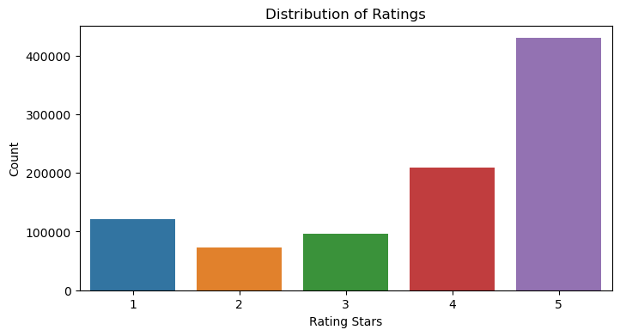
Data Exploration
Distribution of Ratings

Slide 6
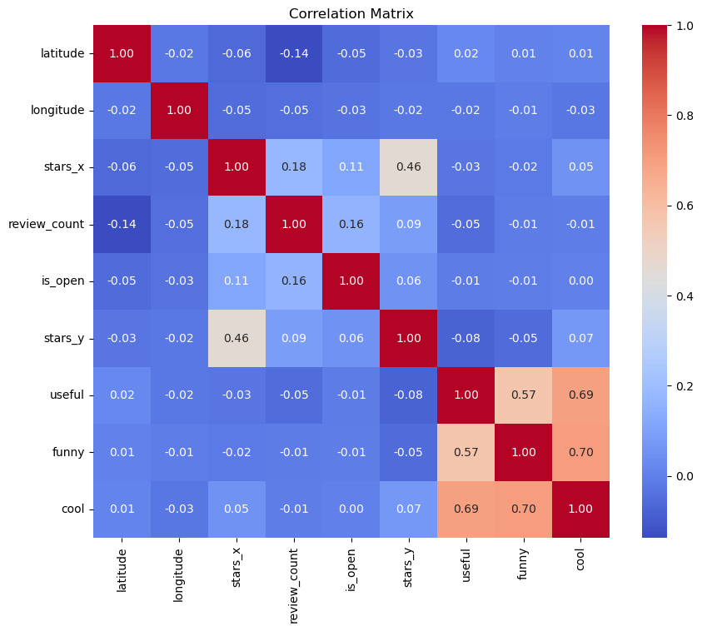
Correlation matrix

Slide 7
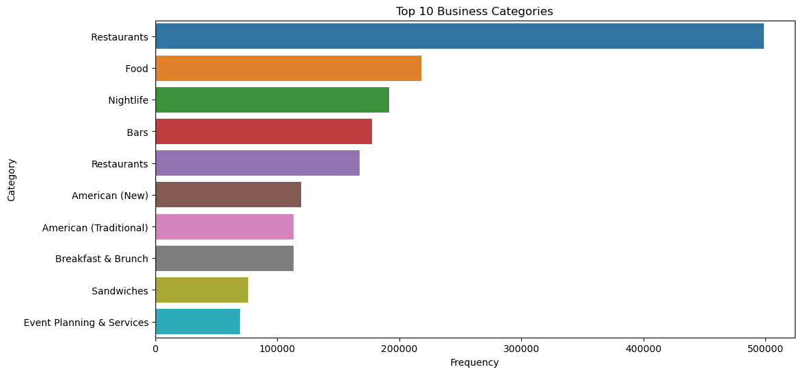
Top 10 Business Categories

Slide 8
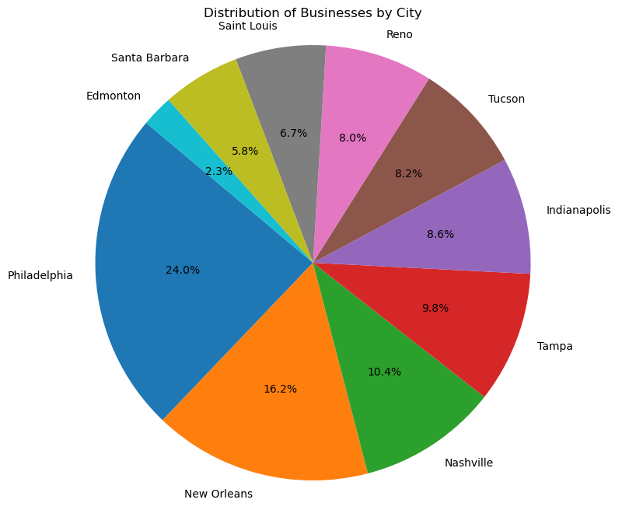
Distribution of Businesses by City

Slide 9
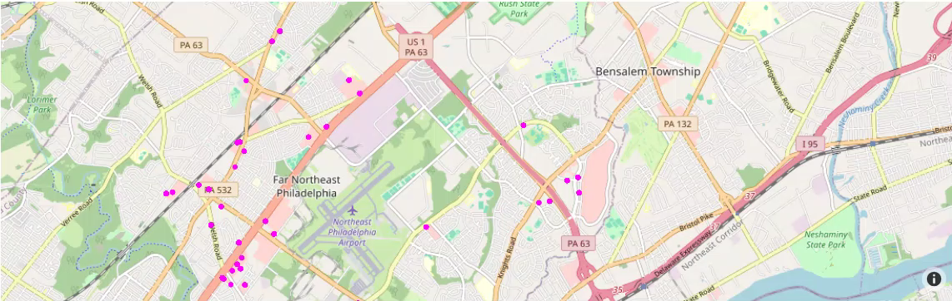
Distribution of Restaurants across Philadelphia

Slide 10

Data Mining Tasks
Importing and reading data which provided an understanding of the data structure and format
Creating subsets
Handling missing values
Handling categories by creating a series
Handling nested attributes
- Extracting keys from nested dictionary
- Converting string to dictionary

Slide 11
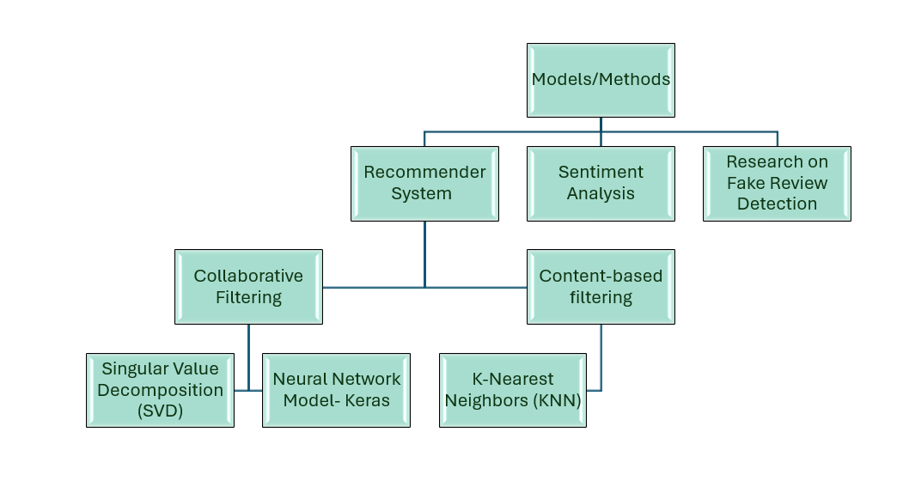
Data Mining Models/Methods

Slide 12
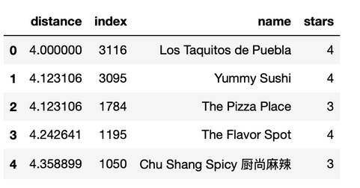
RECOMMENDER SYSTEM
Content-based filtering
DATA SPLITTING | MODEL IMPLEMENTATION AND FITTING | MODEL TESTING | DISTANCE CALCULATION | RECOMMENDATION TABLE CREATION | INITIAL RECOMMENDATIONS
80% training 20% testing | KNN Model has been used | Last row of the dataset is designated as a validation set | Distances between the validation set and other restaurants in the dataset are computed based on their similar features | Displays restaurants similar to the validation set based on their distances
Adelita Taqueria & Restaurant
Model accuracy ~ 51%

Slide 13
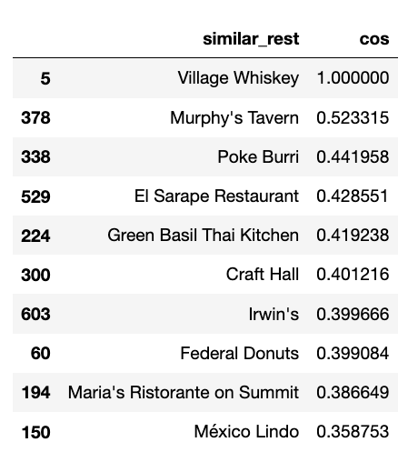
Colaborative Filtering - Singular Value Decomposition (SVD) & NN - Keras
SINGULAR VALUE
DECOMPOSITION (SVD)
Extracting top restaurants
Creating User-Item matrix
Decomposing the user size to get generalized view of the user's taste
Restaurants with maximum correlation with the most famous restaurant which are the recommendations
1
NEURAL NETWORK - KERAS
Model implementation & Training phase
Predictions based on embedding layer
Recommendations through cosine similarity
2

Slide 14

Sentimental Analysis
Serves as a key indicator for businesses to gauge the overall sentiment of customers towards their products or services
Gain invaluable insights, identify patterns in customer feedback, and pinpoint areas of strength or weaknesses
Improved customer retention and loyalty

Slide 15




THE PROCESS
Text Tokenization
Model training and evaluation
1
2
3
4
5
Preprocessing the raw text data
TF-IDF Vectorization
Classification into positive/negative categories

Slide 16
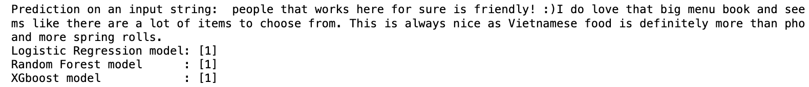
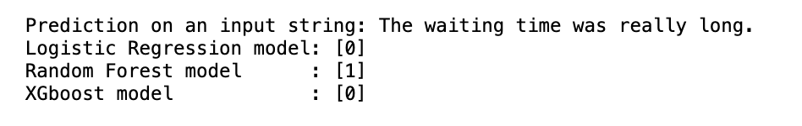
LOGISTIC REGRESSION
Textual feature extraction
Model training
Prediction
Evaluation
1
Machine Learning Models used
Model implementation
Training phase
Aggregation of predictions
Robustness and accuracy
Evaluation and performance
RANDOM FOREST
CLASSIFIER
2
XGBOOST
Model implementation
Gradient boosting algorithm
Optimization techniques
Feature importance
Evaluation and performance
3

Slide 17


PERFORMANCE METRICS
LOGISTIC REGRESSION | RANDOM FOREST | XGBOOST
Precision : 92.4% Recall : 91.4% F1 Score : 91.7% | Precision : 88.9% Recall : 89.1% F1 Score : 89% | Precision : 90.9% Recall : 90.8% F1 Score : 90.8%
Best model

Slide 18
91.4%
Logistic Regression model accuracy
With the highest precision, recall, and F1 score among the three models, logistic regression demonstrates its effectiveness in accurately identifying positive reviews and capturing a significant portion of positive instances in the dataset. Its balanced performance suggests that it can reliably distinguish between positive and negative sentiments.

Slide 19
FUTURE SCOPE
We can extend the use of positive and negative reviews in the sentimental analysis for detecting fake reviews.
The recommender system can be used by third party apps for their users to get close suggestions of restaurant in which they have previously visited.

Slide 20


Thank you very much!
Presented by-
Sparsh Marwah
Medhavi Pande
Sharvari Deshpande

